Slide 1
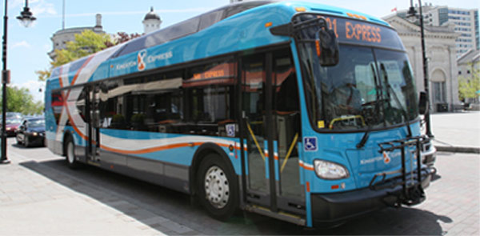
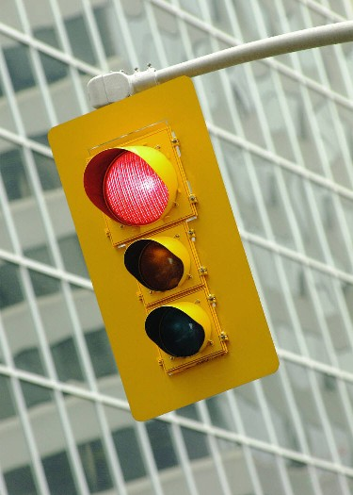

January 2018
Transit Signal Priority Project

Slide 2
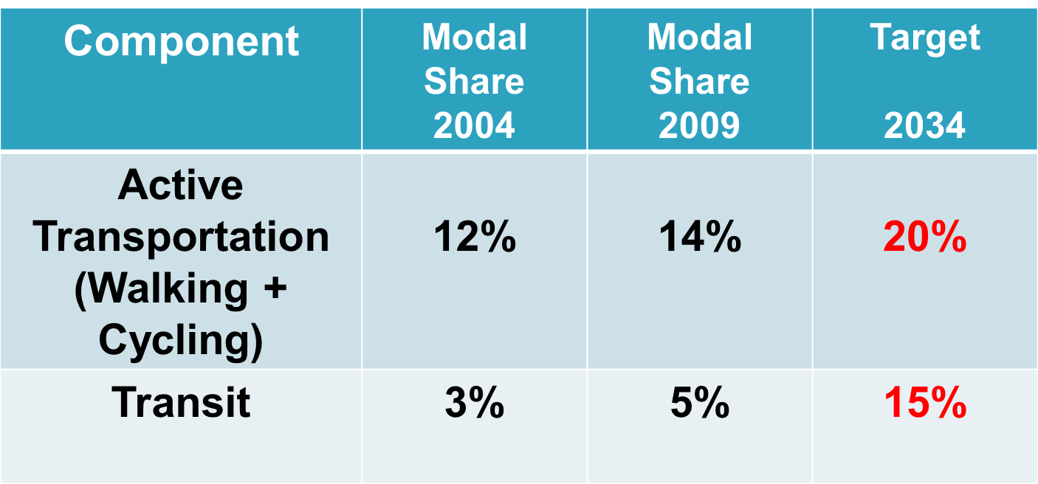
City of Kingston Transportation Targets by 2034

Slide 3
What is Transit Signal Priority (TSP)?
Reduces delays for buses as follows:
Green extension: extends the green light so that the bus can get through the intersection
Red truncation: if a bus is waiting on a red, TSP will get the green to come back faster so the bus doesn’t wait as long

Slide 4
How does TSP work?
The EMTRAC system utilizes GPS technology and spectrum radio to enable transit vehicles to request priority through signalized intersections.
Vehicles with the EMTRAC system transmit a priority request to equipped intersections when passing through detection zones.
The traffic cabinet at the intersection contains an EMTRAC Priority Detector, which relays the priority request call to the traffic controller.
EMTRAC is completely automatic and requires no driver interaction.
EMTRAC can be configured to allow priority control based on time of day, direction traveled, or other factors.

Slide 5
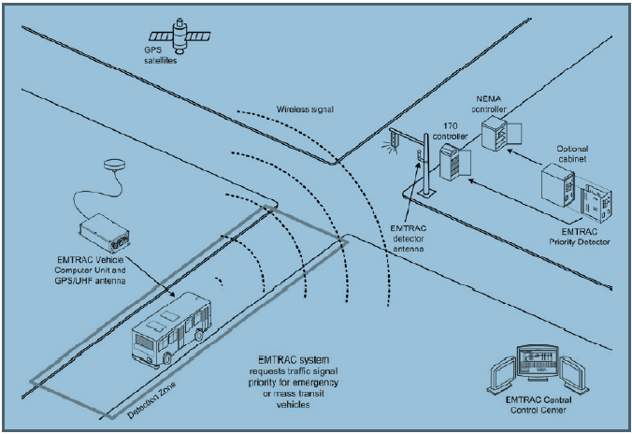
How does TSP work?

Slide 6
Background
Transit signal priority transponders installed on Express Buses only (Route 501 & 502) at 3 intersections:
Princess Street & Gardiners Road
Princess Street & Midland Avenue
Princess Street & Bayridge Drive

Slide 7
Project Objectives
Determine the total overall impact of TSP at each intersection:
For 501 & 502 buses estimate the following:
Time savings
Fuel savings
Greenhouse gas (GHG) emission reductions
For all other vehicles at each intersection, estimate the following:
Potential time delay
Potential fuel increase
Potential greenhouse gas (GHG) emission increase

Slide 8
Assumptions
Traffic signal timings provided must be used
Assume all traffic signal timing phases will operate with maximum greens
Green extension for all TSP movements is 15 seconds maximum
Red truncation removes 5 seconds from each subsequent phase to return to transit vehicle
Note that all 3 pilot intersections are “fully actuated” (see traffic signal timing course)

Slide 9
Assumptions
Assume that TSP equipment is on all 501 and 502 Kingston Transit express buses
Project to be based on busiest 4 hours of day (must use provided traffic volumes)
Groups will need to use the Kingston Transit Schedule and consider variable arrivals at each traffic signal and evaluate a variety of scenarios

Slide 10
Available Information
Traffic signal timings
Traffic counts
Kingston Transit routing & schedule (available on-line)
Transit priority movements
GIS mapping

Slide 11
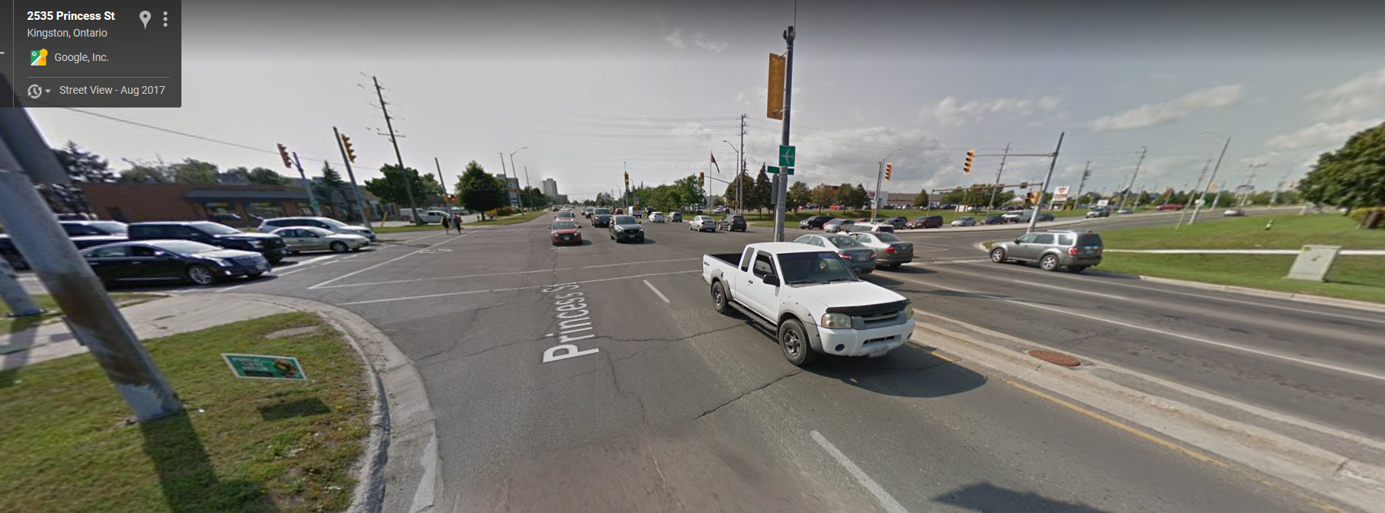
Princess Street & Gardiners Road

Slide 12
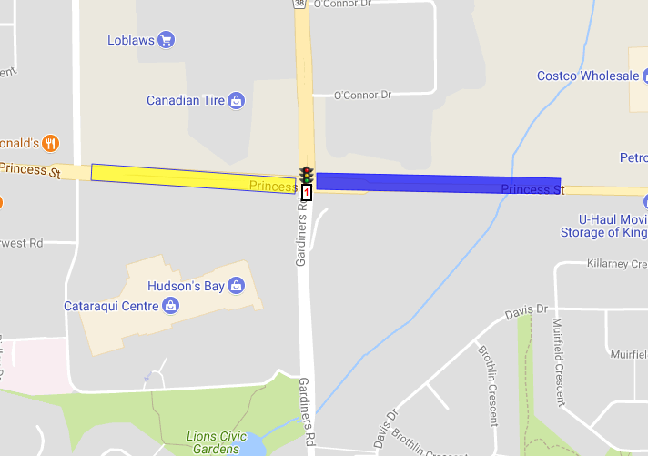
Princess Street & Gardiners Road
Transit Priority: WBL (502) & EBT(501)

Slide 13
Princess Street & Gardiners Road
Traffic Signal Timings

Slide 14
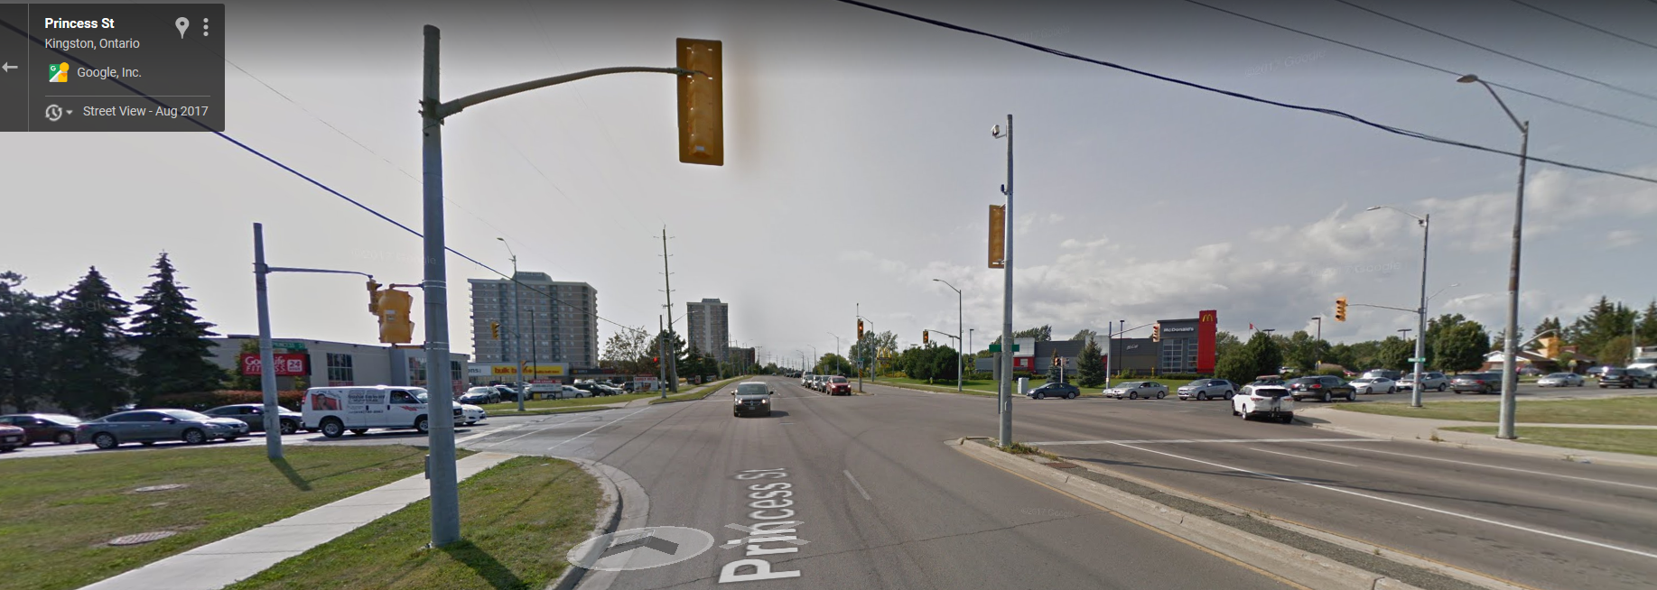
Princess Street & Midland Avenue

Slide 15
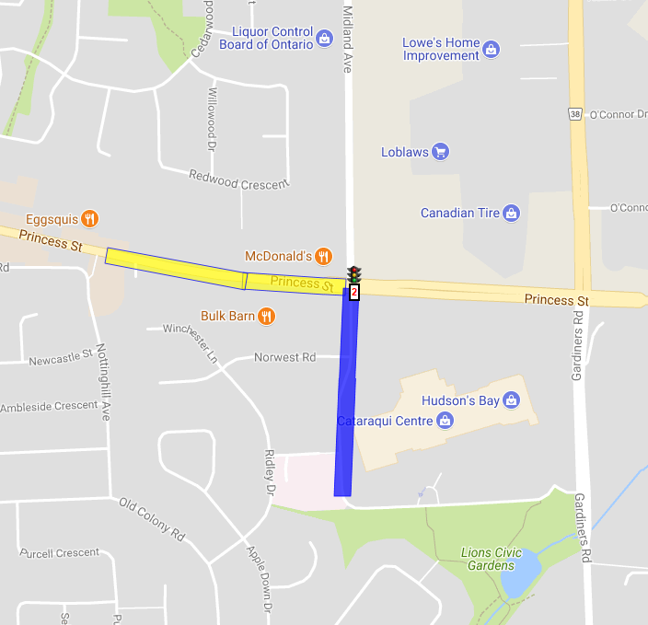
Princess Street & Midland Avenue
Transit Priority: NBL (502) & EBR (501)

Slide 16
Princess Street & Midland Avenue
Traffic Signal Timings

Slide 17
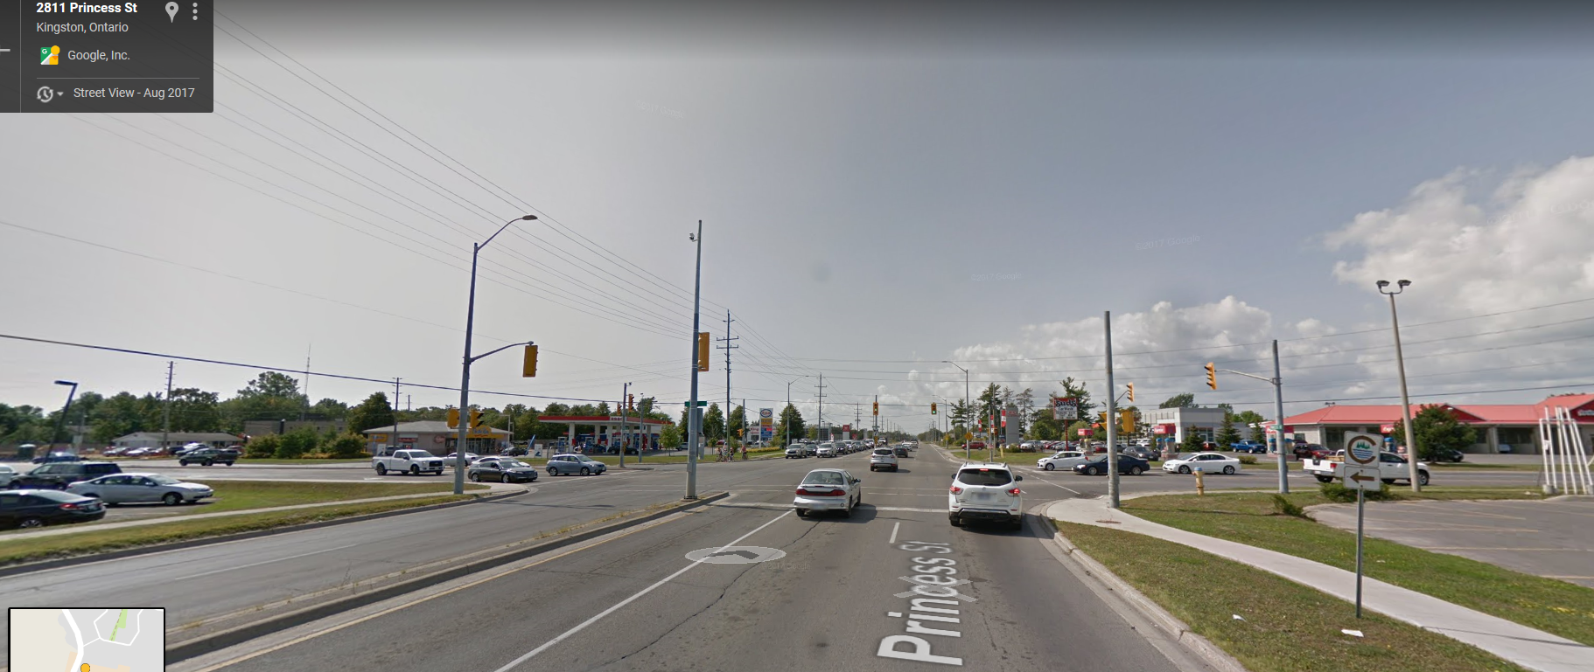
Princess Street & Bayridge Drive

Slide 18
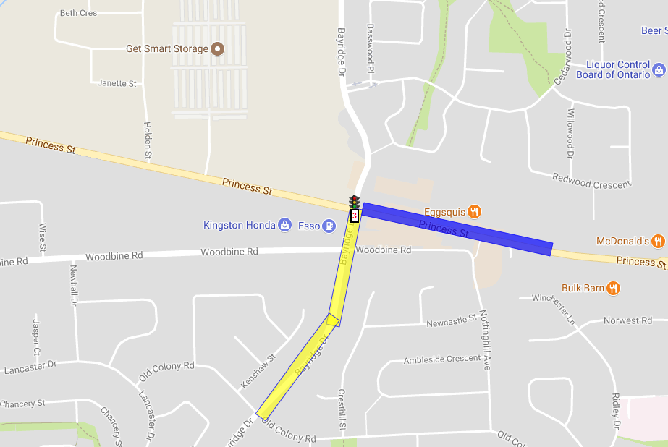
Princess Street & Bayridge Drive
Transit Priority: WBL (502) & NBR (501)

Slide 19
Princess Street & Bayridge Drive
Traffic Signal Timings

Slide 20
Contacts

Slide 21

Questions

